Slide 1
Tamworth Landfill Monitoring
Chemicals of emerging concern have just been detected - PFAS
Presented by Ned Beecher, Alternate, Tamworth Conservation Commission

Slide 2
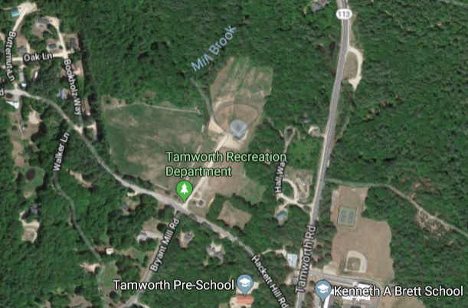

Slide 3
Tamworth landfill was closed in ~2000.
Monitoring plan has been in place since closing, overseen by NH DES; includes annual testing for:
gas (methane)
metals, nitrate, & other chemicals, etc. in up-gradient & down-gradient wells
“closure construction completed in August of 2003…. The site was covered with an LLDPE membrane cap and soil cover. With only a few exceptions, there appears to be an overall stable and/or decreasing trend in both the inorganic and organic compounds. Therefore, we believe the RAP [remedial action plan] is functioning as anticipated. HEB anticipates continued monitoring of this site per the GWP requirements.”
-- HEB, Tamworth Landfill Groundwater Plan Renewal

Slide 4
Monitoring results – generally good
Over the years, no significant issues found; a few things were identified & investigated further:
Not long after landfill closing: methane found in monitoring wells; followed up with testing in neighbors’ basements; no significant issues found
a few manganese detections in 2000s; downward trend overall
benzene detected in one (upgradient) well in 2016; further test showed it below standard (AGQS)
Generally good news; not out of the ordinary.
One to watch: arsenic; trending up some, and state is changing standard downward to 5 ppb.
And now PFAS…

Slide 5
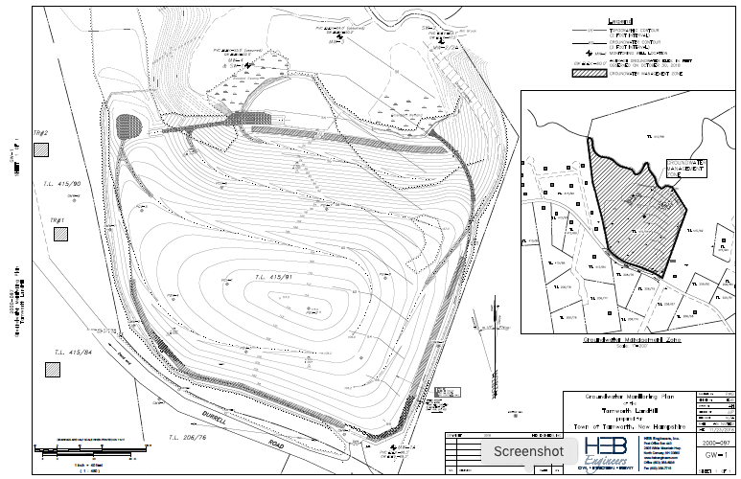
Tamworth Landfill – groundwater flow

Slide 6
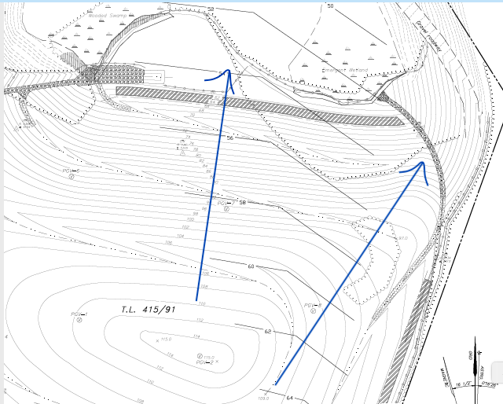
Tamworth Landfill – groundwater flow

Slide 7
PFAS – What Are They?
PFAS = Per- and Poly- Fluorinated Alkyl Substances (sometimes called PFCs, but PFAS is a better term). PFOA and PFOS are the most common, most researched, most concerning, & have been phased out of most uses in U. S…
F
O
F
F
F
F
F
F
Fluorocarbon tail
F
Strong bonds
Hydrophobic
Oleophobic
Varying length
F
OH
Functional group
F
F
F
F
F
F
Strong to weak acids
Hydrophilic
perfluorooctanoic acid (PFOA)
F
O
F
F
F
F
F
F
Also Note:
Precursors
& Substitutes –
Gen-X, Adona, et al.
F
More than 3,000 PFAS compounds identified
F
S
OH
F
F
F
F
F
F
F
F
O
perfluorooctane sulfonic acid (PFOS)
Slide courtesy Steve Zemba, Sanborn Head
Notes:
PFOA and PFOS are the most studied compounds – lots of the info presented on PFAS is probably mostly pertinent to PFOA and PFOS

Slide 8
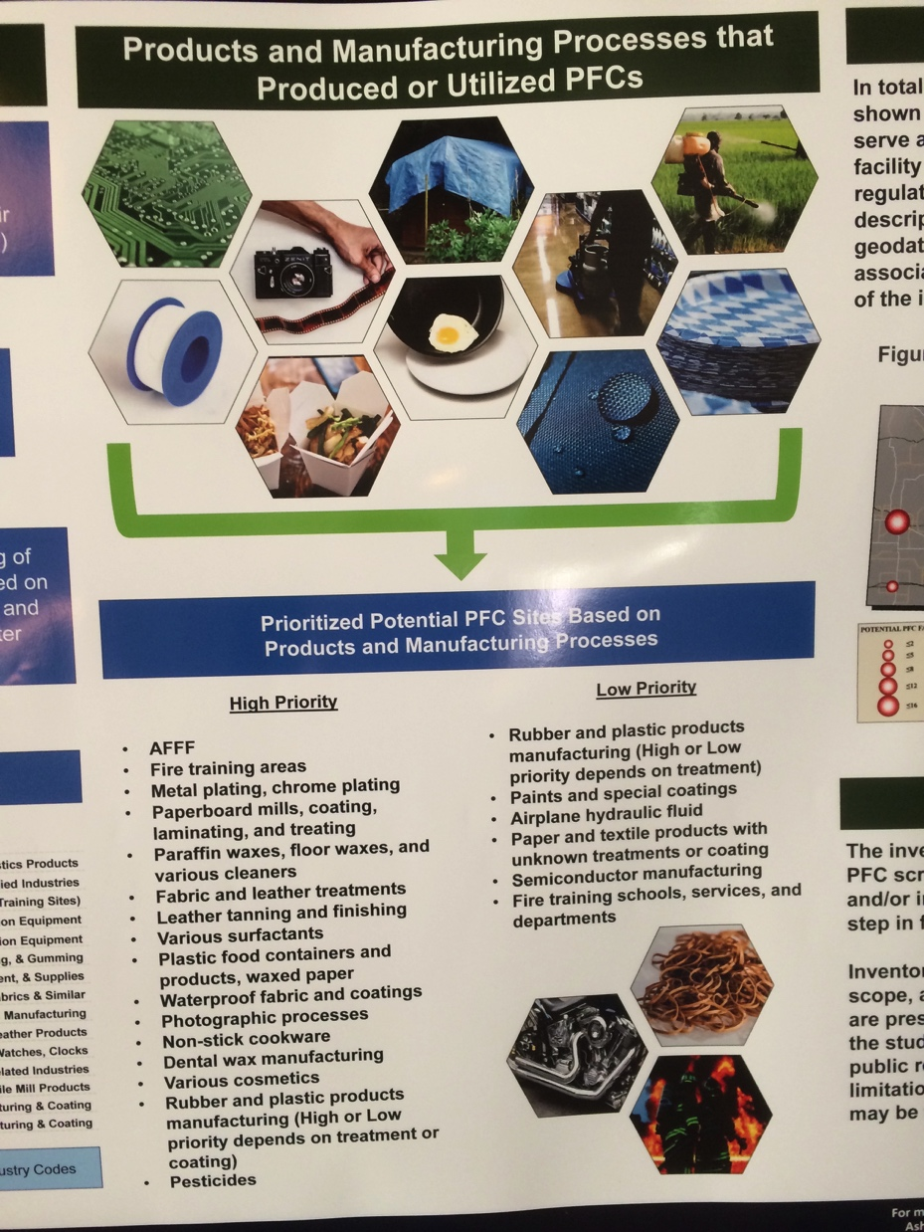
Uses (State of Nebraska)

Slide 9
https://fluorocouncil.com/

Slide 10
PFAS – The Basics
Water soluble, hydrophobic, lipophobic, bind to proteins
Persistent – C8 and lower versions do not degrade
Not volatile, resists photolysis & hydrolysis
Transport pathways: air deposition, leaching & groundwater, surface water
Human exposure through drinking water (focus), food & food packaging, indoor dust & product exposure, use of consumer products
Sorption & solubility differences
3000+ varieties, co-contaminants
Destroyed at ~1000º C
No natural counterparts
Notes:
PFOA and PFOS are the most studied compounds – lots of the info presented on PFAS is probably mostly pertinent to PFOA and PFOS

Slide 11
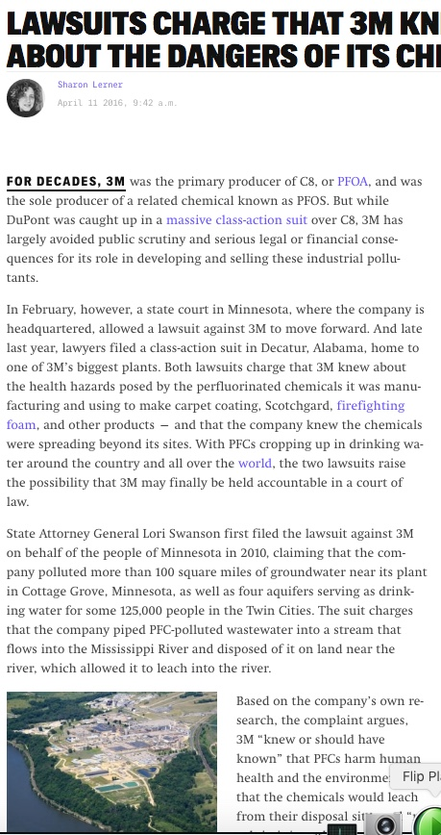
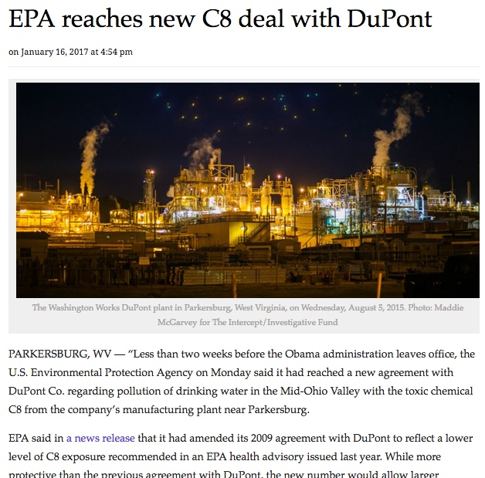
Cottage Grove, MN:
Major sources of PFAS: Chemical manufacturing sites
Parkersburg, WV:

Slide 12
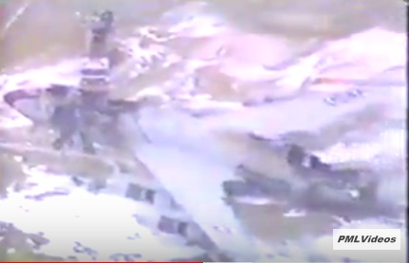
This is a major source of PFAS: AFFF Pease AFB, NH
All the white is AFFF (PFAS-containing foam)
https://www.youtube.com/watch?v=8W_zJfJGhSI&feature=youtu.be

Slide 13
PFAS Health Risks - Summary
Toxicity of PFOA & PFOS not certain – some health effects
Epidemiological studies and laboratory animal studies have not shown consistent and conclusive findings, but some toxicologists suggest lower drinking water limits than EPA’s current advisory.
Cancer incidence studies in NY, NH, and MN do not show PFAS effects. Most Americans have been exposed to low levels decades.
If PFAS are causing health effects, the effects appear to be subtle.
Current risk-based standards/guidelines for PFOA and PFOS are protective (e.g. EPA’s public health advisory, Health Canada)
Reasons for concern
PFAS in drinking water elevates PFAS in blood
Less data for PFASes other than PFOA and PFOS
Slide courtesy Steve Zemba, Sanborn Head

Slide 14
The major health concern now is exposure via drinking water.
EPA initial health advisory pre-2016:
PFOA + PFOS = 600 ng/L (ppt) screening level
EPA long-term public health advisory May 2016: PFOA + PFOS = 70 ng/L (ppt) screening level
Driven by research like the C8 study around Parkersburg, WV
Many water utilities & well owners suddenly had to act in 2016, because some drinking waters tested above 70 ppt.
Only common contaminants regulated in ppts!
1 ppt = 1 second in 31,700 years! Or 1 drop of water in 20 Olympic-sized pools!

Slide 15
Uncertainty factors applied
Uncertainty factor of ~60x.
Current range being considered in NH: 3.5x factor (70 – 20 ppt)
Factor of 5x.
Uncertainty factor of ~280x.

Slide 16
What’s being done about it?
NH has been one of the most proactive states on the PFAS issue (DHHS, DES). 1000s of wells tested.
Most states are using EPA advisory level of 70 ppt PFOA + PFOS and monitoring, investigating.
MN, NJ, MI, NY, and VT have applied lower drinking water standards (VT = 20 ppt)
EPA Action Plan – February 14, 2019
NH DES setting MCLs for 4 PFAS now, proposed at 70 ppt and lower.
The Bearcamp Valley School well (upgradient) was tested & no PFAS found.

Slide 17
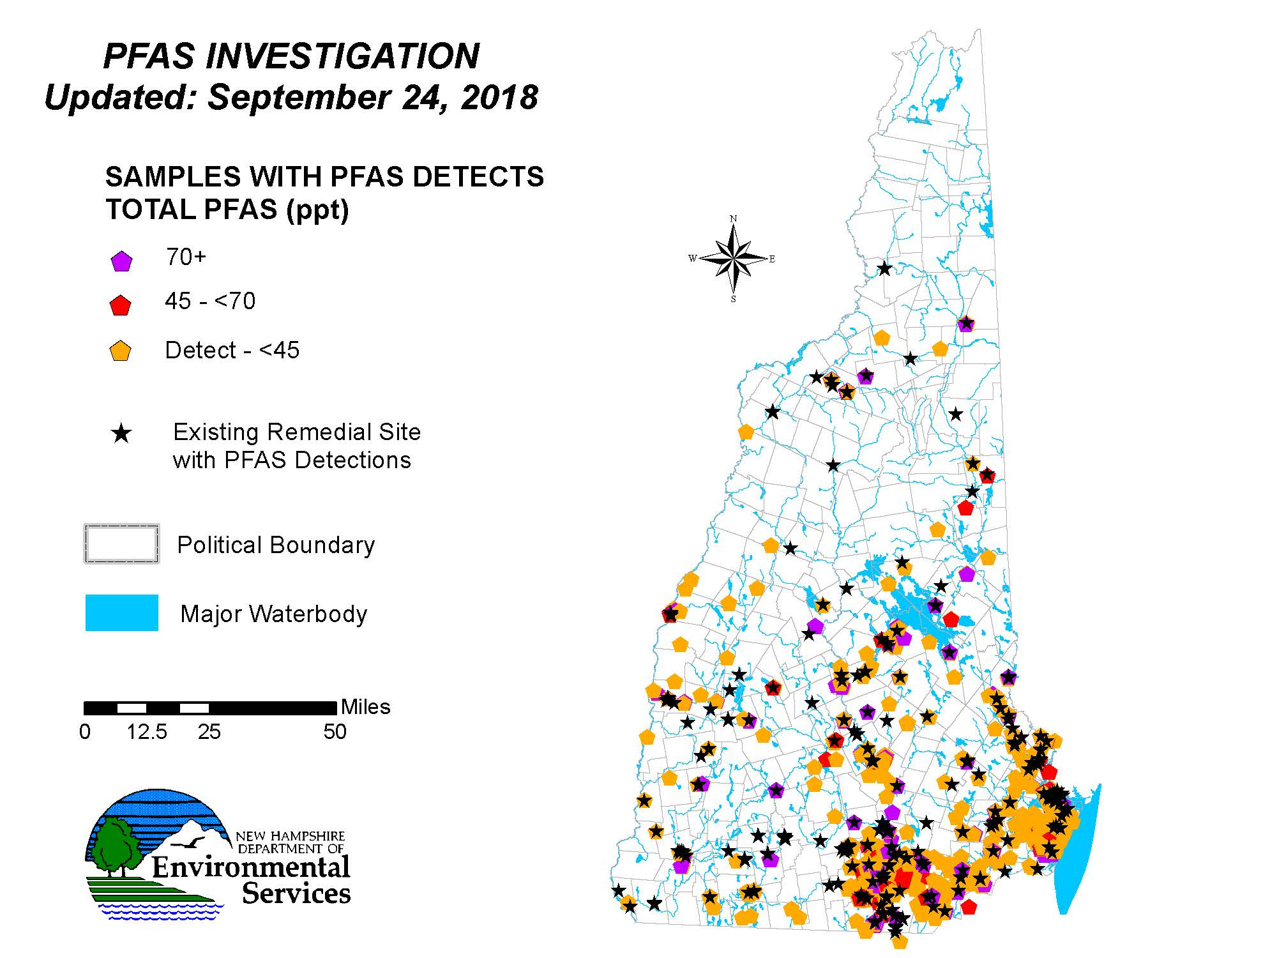
NH PFAS investigations…

Slide 18
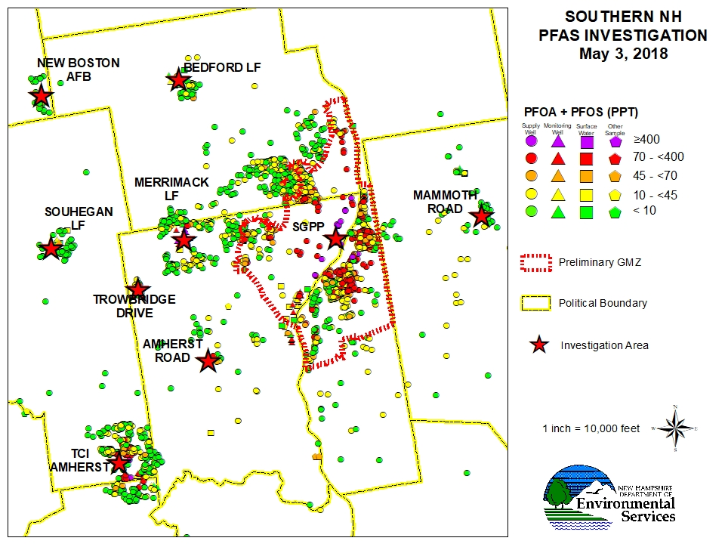
What a bigger NH contamination site looks like…

Slide 19
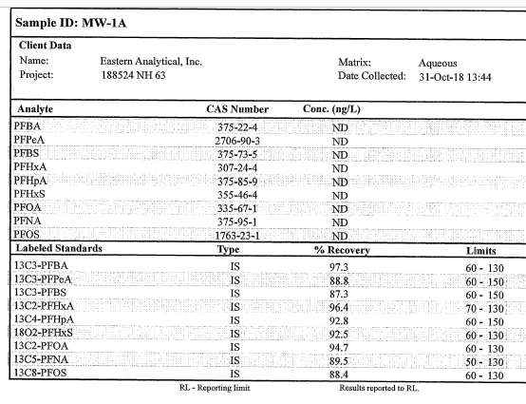
Tamworth landfill results: MW-1A upgradient

Slide 20
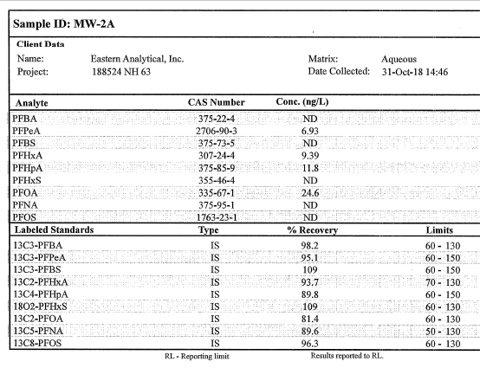
Tamworth landfill results: MW-2A downgradient
Total PFOA + PFOS = 24.6 ppt. Below 70 ppt AGQS.
This is not drinking water. Dilution & attenuation are expected.

Slide 21
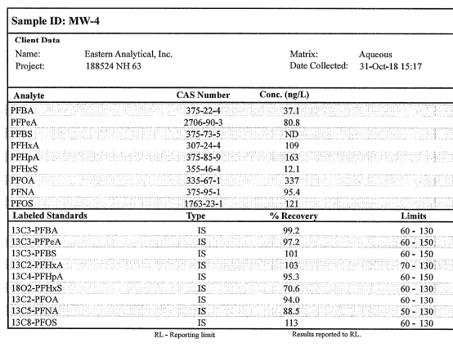
Tamworth landfill results: MW-4 downgradient
Total PFOA + PFOS = 458 ppt
This is not drinking water. Dilution & attenuation are expected. But further investigation is warranted.

Slide 22
Proposed next step: well testing
NH DES is requiring testing of neighboring drinking water wells within 500 ft., even when somewhat downgradient of landfill.
HEB plan is to sample well water in Tamworth Mobile Home Park, with resident approval/involvement, in the next couple of weeks.
For comfort, Town proposes also sampling wells to the side (not downgradient) – day care & rec field.
What happens after that depends on results.

Slide 23
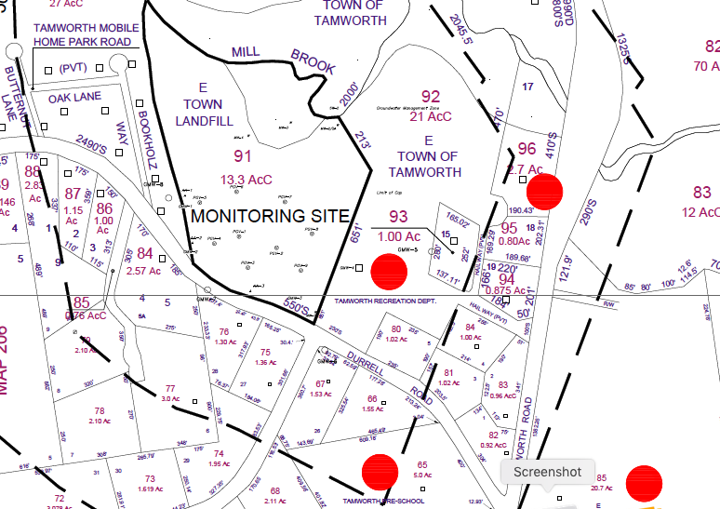
HEB Engineers Proposed Plan

Slide 24
Summary
PFAS are widely used & found in many places.
PFOA and PFOS – the most known & researched – are phased out of most uses & diminishing in us.
Some scientists see health concerns for drinking water in the parts-per-trillion level.
EPA’s advisory is 70 ppt; DES is following that now, but is currently rulemaking to set likely lower MCLs.
Prudent action: Test drinking water wells where PFAS has been found nearby and may be present.
Tamworth landfill is releasing typical low levels of PFAS, like other town landfills
Plans have been drafted to investigate further with testing of neighbor wells.

Slide 25
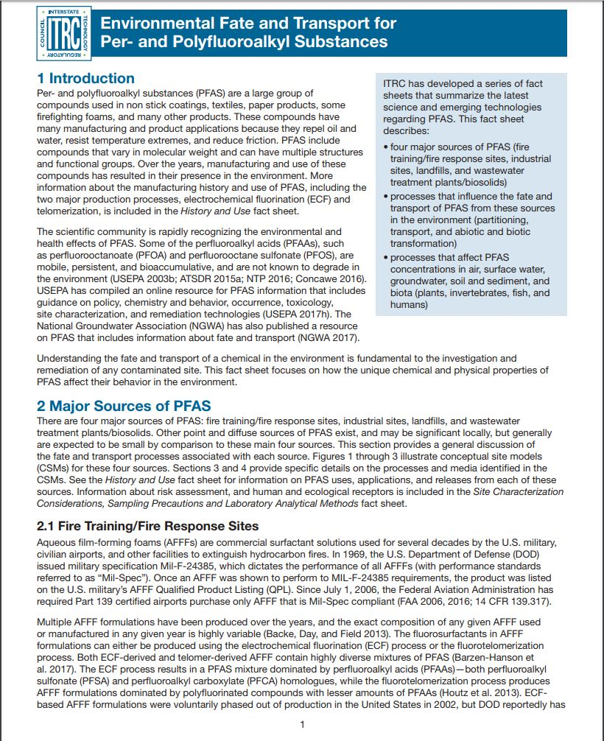
Resources for more info
General:
http://pfas-1.itrcweb.org/
https://www4.des.state.nh.us/nh-pfas-investigation/
Health info:
https://www.atsdr.cdc.gov/pfas/index.html
http://www.health.gov.au/internet/main/publishing.nsf/Content/ohp-pfas-expert-panel.htm
Drinking water standards:
https://www.epa.gov/pfas
https://www.canada.ca/en/services/health/publications/healthy-living/water-talk-drinking-water-screening-values-perfluoroalkylated-substances.html

Slide 26
Questions? Feedback?
This presentation will be available on the Town website.

Slide 27
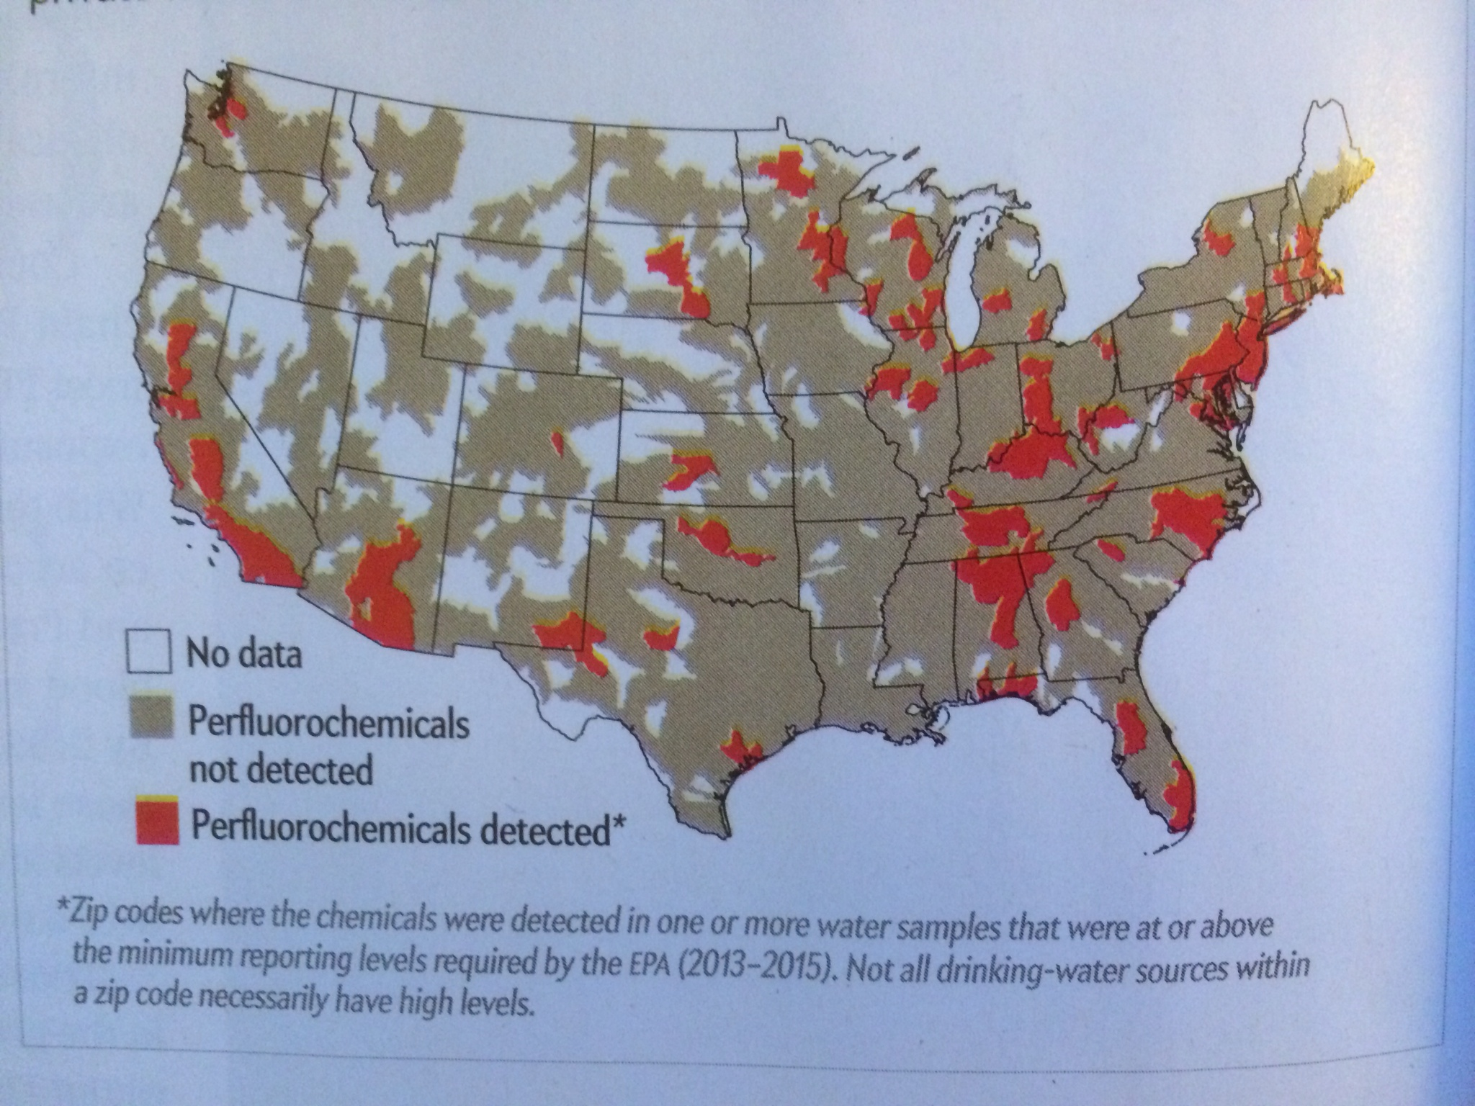
Known U. S. PFAS hot spots, 2016. More found since (Hu et al. 2016).

Slide 28
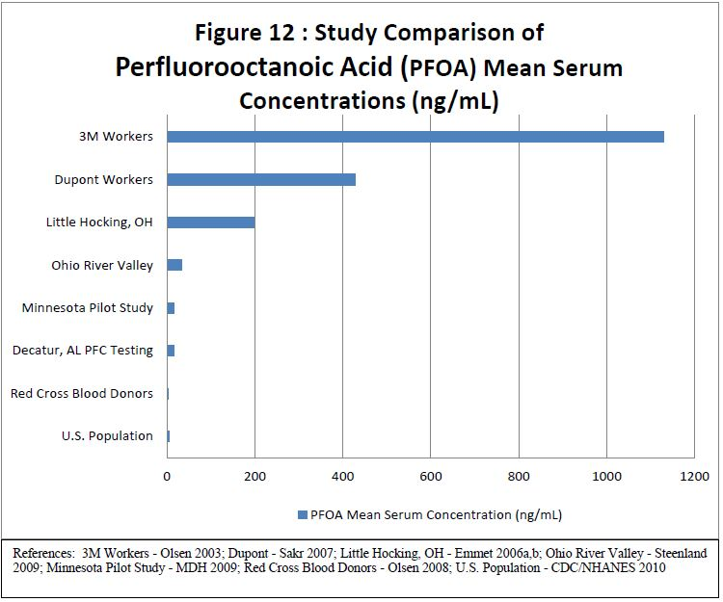
Blood Serum PFAS Concentration Comparisons
PFOA
(ATSDR, 2013)

Slide 29
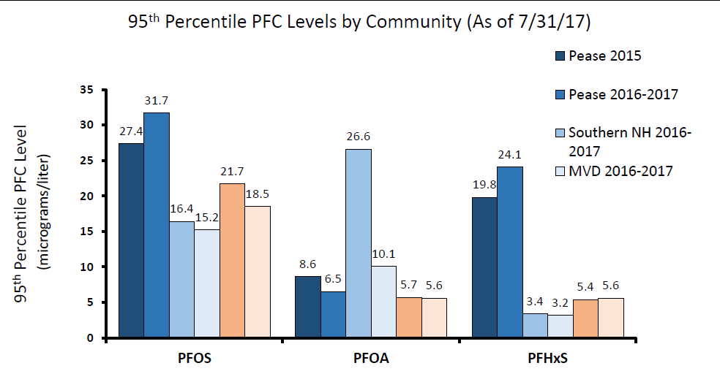
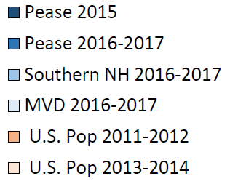
Human Blood Testing in NH
https://www.dhhs.nh.gov/media/pr/2017/10102017-pfc-findings.htm

